Slide 1
CUSTOMER PREDICTION
BA TECHNOLOGY, DATA AND INSIGHTS

Slide 2
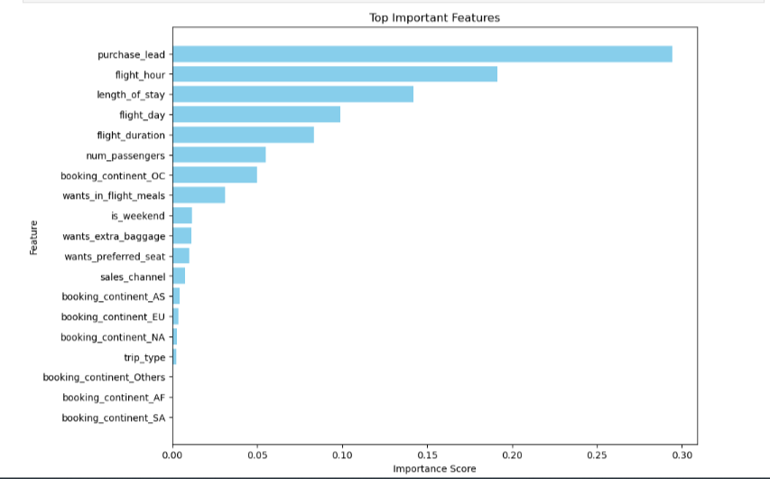
RESULTS
EVALUATION
The most important feature in the model was
Purchase_lead that is the time between purchase
Departure.
Information about the flight, e.g. flight time and
Duration was also significant, however booking origin
of the customer was not important.
The accuracy of the model was approximately 0.75.

